Slide 1

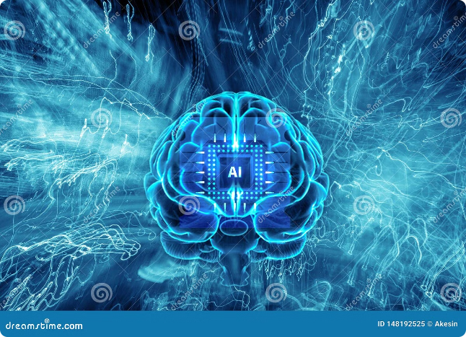

Deep Learning: A Journey into Artificial Intelligence
Deep learning is a subfield of machine learning that uses artificial neural networks to analyze large datasets, learn patterns, and make predictions. It has revolutionized various fields, from image recognition to natural language processing.
Presented by
Rohit Dahiya

Slide 2

Fundamentals of Neural Networks
Perceptrons
Activation Functions
Backpropagation
The simplest form of neural network, perceptrons learn to classify data by adjusting weights associated with input features.
Non-linear functions, like sigmoid or ReLU, determine the output of a neuron, adding complexity to the network.
A key algorithm that allows neural networks to learn by adjusting weights to minimize errors in predictions.

Slide 3

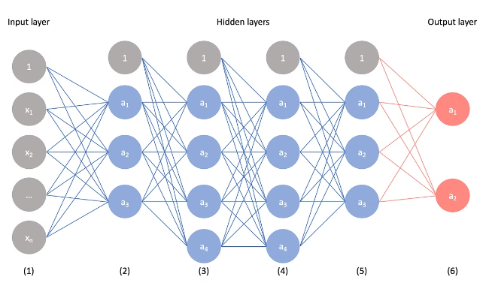
Convolutional Neural Networks (CNNs)
1
Image Recognition
2
Feature Extraction
CNNs excel at identifying objects and patterns within images, achieving high accuracy in tasks like facial recognition and object detection.
Convolutional layers extract features from images through filters, capturing key information like edges, textures, and shapes.
3
Pooling Layers
4
Applications
Pooling layers reduce the dimensionality of the feature maps, simplifying the network while retaining important information.
CNNs are widely used in self-driving cars, medical imaging analysis, and image-based search engines.

Slide 4

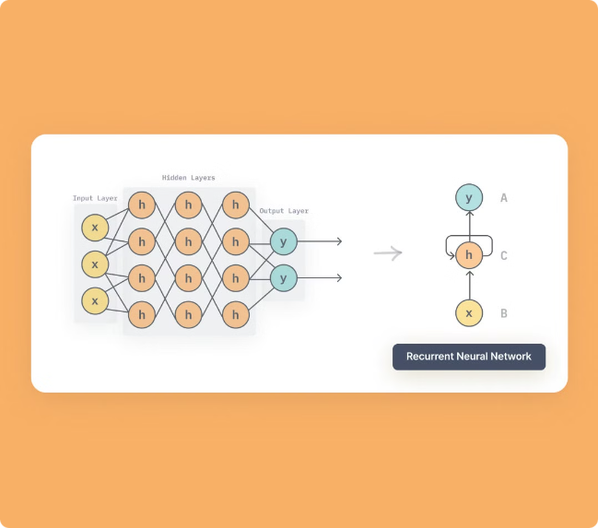
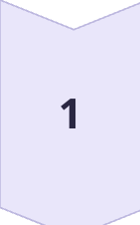
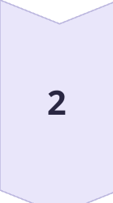
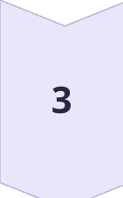
Recurrent Neural Networks (RNNs)
Sequential Data
RNNs are designed to handle sequential data, such as text, speech, and time series, where context matters.
Memory
RNNs have internal memory that allows them to remember previous inputs, enabling them to learn patterns and relationships over time.
Applications
RNNs are used in language translation, machine translation, and text generation.

Slide 5

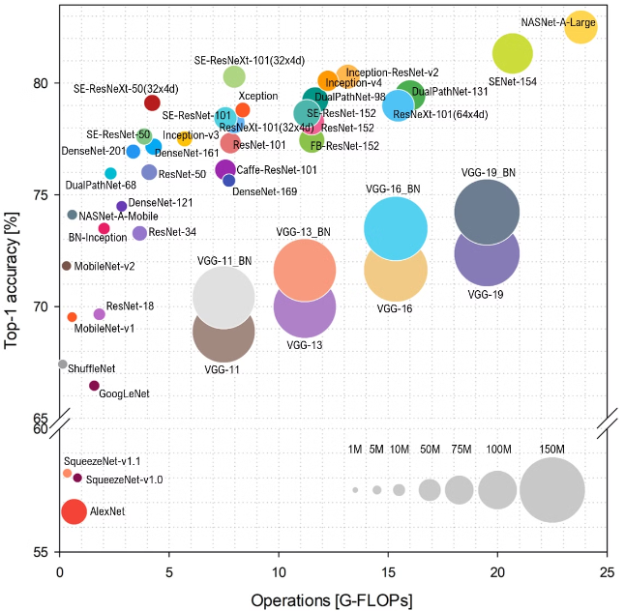
Advancements in Deep Learning Architectures
Generative Adversarial Networks (GANs)
Transformers
Transformers excel in language processing tasks, enabling high-quality translation and text generation.
GANs consist of two competing networks, a generator and a discriminator, that work together to create realistic data.
Capsule Networks
Capsule networks capture spatial relationships between features, making them better suited for tasks requiring precise object recognition.

Slide 6

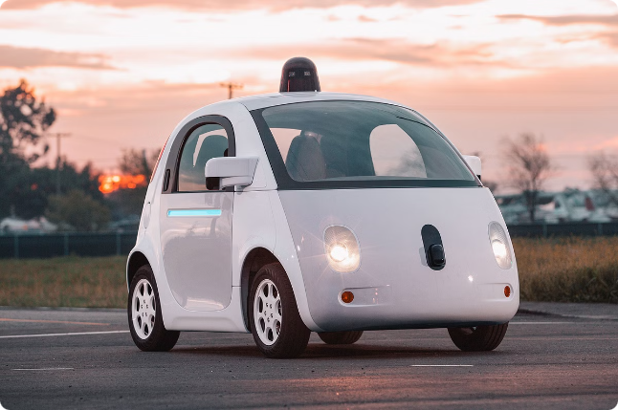
Real-World Applications of Deep Learning
Healthcare
Disease diagnosis, drug discovery
Finance
Fraud detection, risk assessment
E-commerce
Recommendation systems, personalized shopping experiences
Transportation
Self-driving cars, traffic optimization

Slide 7

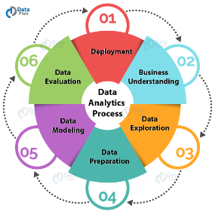




Challenges and Limitations of Deep Learning
Data Requirements
Computational Resources
Explainability
Security and Privacy
Deep learning models often require large amounts of labeled data for effective training.
It can be challenging to understand the decision-making process of deep learning models, leading to concerns about transparency and accountability.
Deep learning models can be vulnerable to adversarial attacks, raising concerns about the security and privacy of sensitive data.
Training deep learning models can be computationally expensive, requiring powerful hardware and infrastructure.

Slide 8

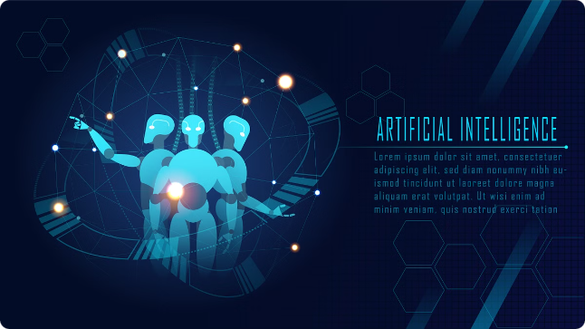
The Future of Deep Learning
1
Personalized Medicine
Deep learning will enable more accurate and personalized medical diagnoses and treatment plans.
2
Human-Computer Interaction
Deep learning will lead to more natural and intuitive interactions between humans and machines.
3
Automation
Deep learning will automate tasks in various industries, increasing efficiency and productivity.

Slide 9


Thank you

